Slide 1
Logical Agents

Slide 2

Knowledge bases
Knowledge base = set of sentences in a formal language
Declarative approach to building an agent (or other system):
TELL it what it needs to know
Then it can ASK itself what to do—answers should follow from the KB
Agents can be viewed at the knowledge level
i.e., what they know, regardless of how implemented
Or at the implementation level
i.e., data structures in KB and algorithms that manipulate them

Slide 3
Knowledge-Based Agent
Agent that uses prior or acquired
knowledge to achieve its goals
Can make more efficient decisions
Can make informed decisions
Knowledge Base (KB): contains a set of representations of facts about the Agent’s environment
Each representation is called a
sentence
Use some knowledge representation language, to TELL it what to know e.g., (temperature 72F)
ASK agent to query what to do
Agent can use inference to deduce new facts from TELLed facts
Domain independent algorithms
ASK
Inference engine
TELL
Knowledge Base
Domain specific content

Slide 4
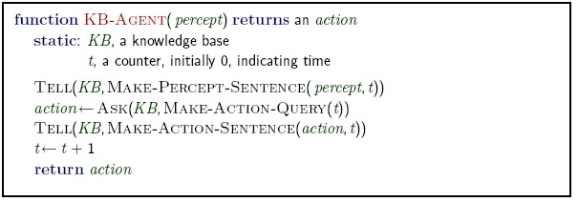
A simple knowledge-based agent
The agent must be able to:
Represent states, actions, etc.
Incorporate new percepts
Update internal representations of the world
Deduce hidden properties of the world
Deduce appropriate actions

Slide 5
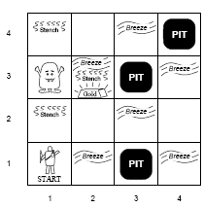
Wumpus World Example
Performance measure
◦ gold +1000, death -1000
-1 per step, -10 for using the arrow
Environment
Squares adjacent to wumpus are smelly
Squares adjacent to pit are breezy
Glitter iff gold is in the same square
Shooting kills wumpus if you are facing it
Shooting uses up the only arrow
Grabbing picks up gold if in same square
Releasing drops the gold in same square
Actuators
Left turn, Right turn, Forward, Grab, Release, Shoot
Sensors
Breeze, Glitter, Smell

Slide 6
Wumpus world characterization
Observable?
Deterministic?
Episodic?
Static?
Discrete?
Single-agent?

Slide 7
Wumpus world characterization
Observable? No—only local perception
Deterministic? Yes—outcomes exactly specified
Episodic? No—sequential at the level of actions
Static? Yes—Wumpus and pits do not move
Discrete? Yes
Single-agent? Yes—Wumpus is a feature

Slide 8
Exploring a wumpus world

Slide 9
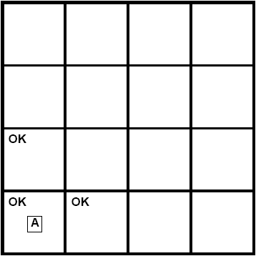
Exploring a wumpus world
A= Agent B= Breeze S= Smell P= Pit
W= Wumpus
OK = Safe V = Visited G = Glitter

Slide 10
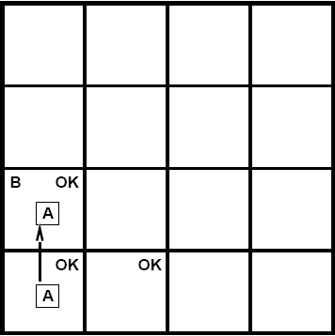
Exploring a wumpus world
A= Agent B= Breeze S= Smell P= Pit
W= Wumpus
OK = Safe V = Visited G = Glitter
10

Slide 11
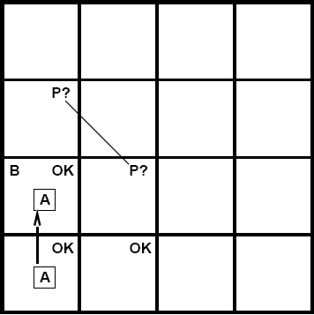
Exploring a wumpus world
A= Agent B= Breeze S= Smell P= Pit
W= Wumpus
OK = Safe V = Visited G = Glitter

Slide 12
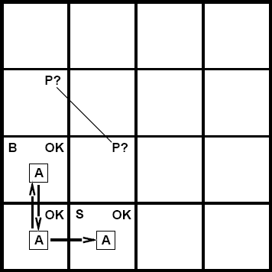
Exploring a wumpus world
A= Agent B= Breeze S= Smell P= Pit
W= Wumpus
OK = Safe V = Visited G = Glitter

Slide 13
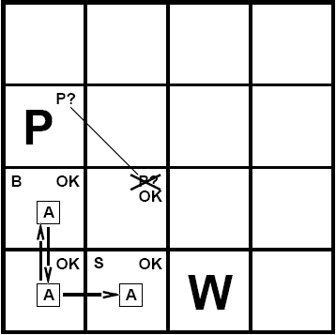
Exploring a wumpus world
A= Agent B= Breeze S= Smell P= Pit
W= Wumpus
OK = Safe V = Visited G = Glitter

Slide 14
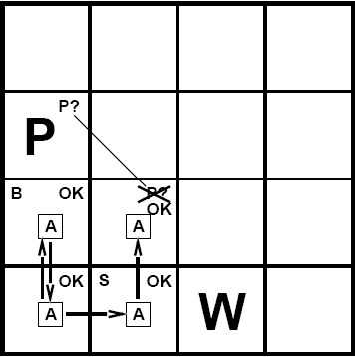
Exploring a wumpus world
A= Agent B= Breeze S= Smell P= Pit
W= Wumpus
OK = Safe V = Visited G = Glitter

Slide 15
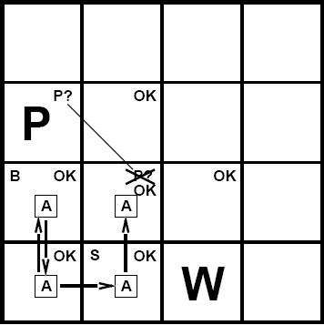
Exploring a wumpus world
A= Agent B= Breeze S= Smell P= Pit
W= Wumpus
OK = Safe V = Visited G = Glitter

Slide 16
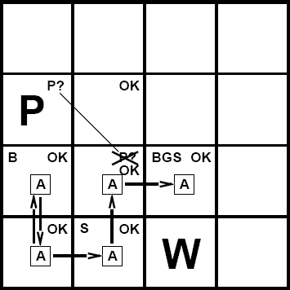
Exploring a wumpus world
A= Agent B= Breeze S= Smell P= Pit
W= Wumpus
OK = Safe V = Visited G = Glitter

Slide 17
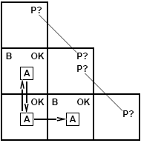
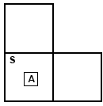
Other tight spots
Breeze in (1,2) and (2,1)
➔ no safe actions
Assuming pits uniformly distributed, (2,2) has pit w/ prob 0.86, vs. 0.31
Smell in (1,1)
➔ cannot move
Can use a strategy of coercion:
shoot straight ahead
wumpus was there ➔ dead ➔ safe wumpus wasn't there ➔ safe

Slide 18
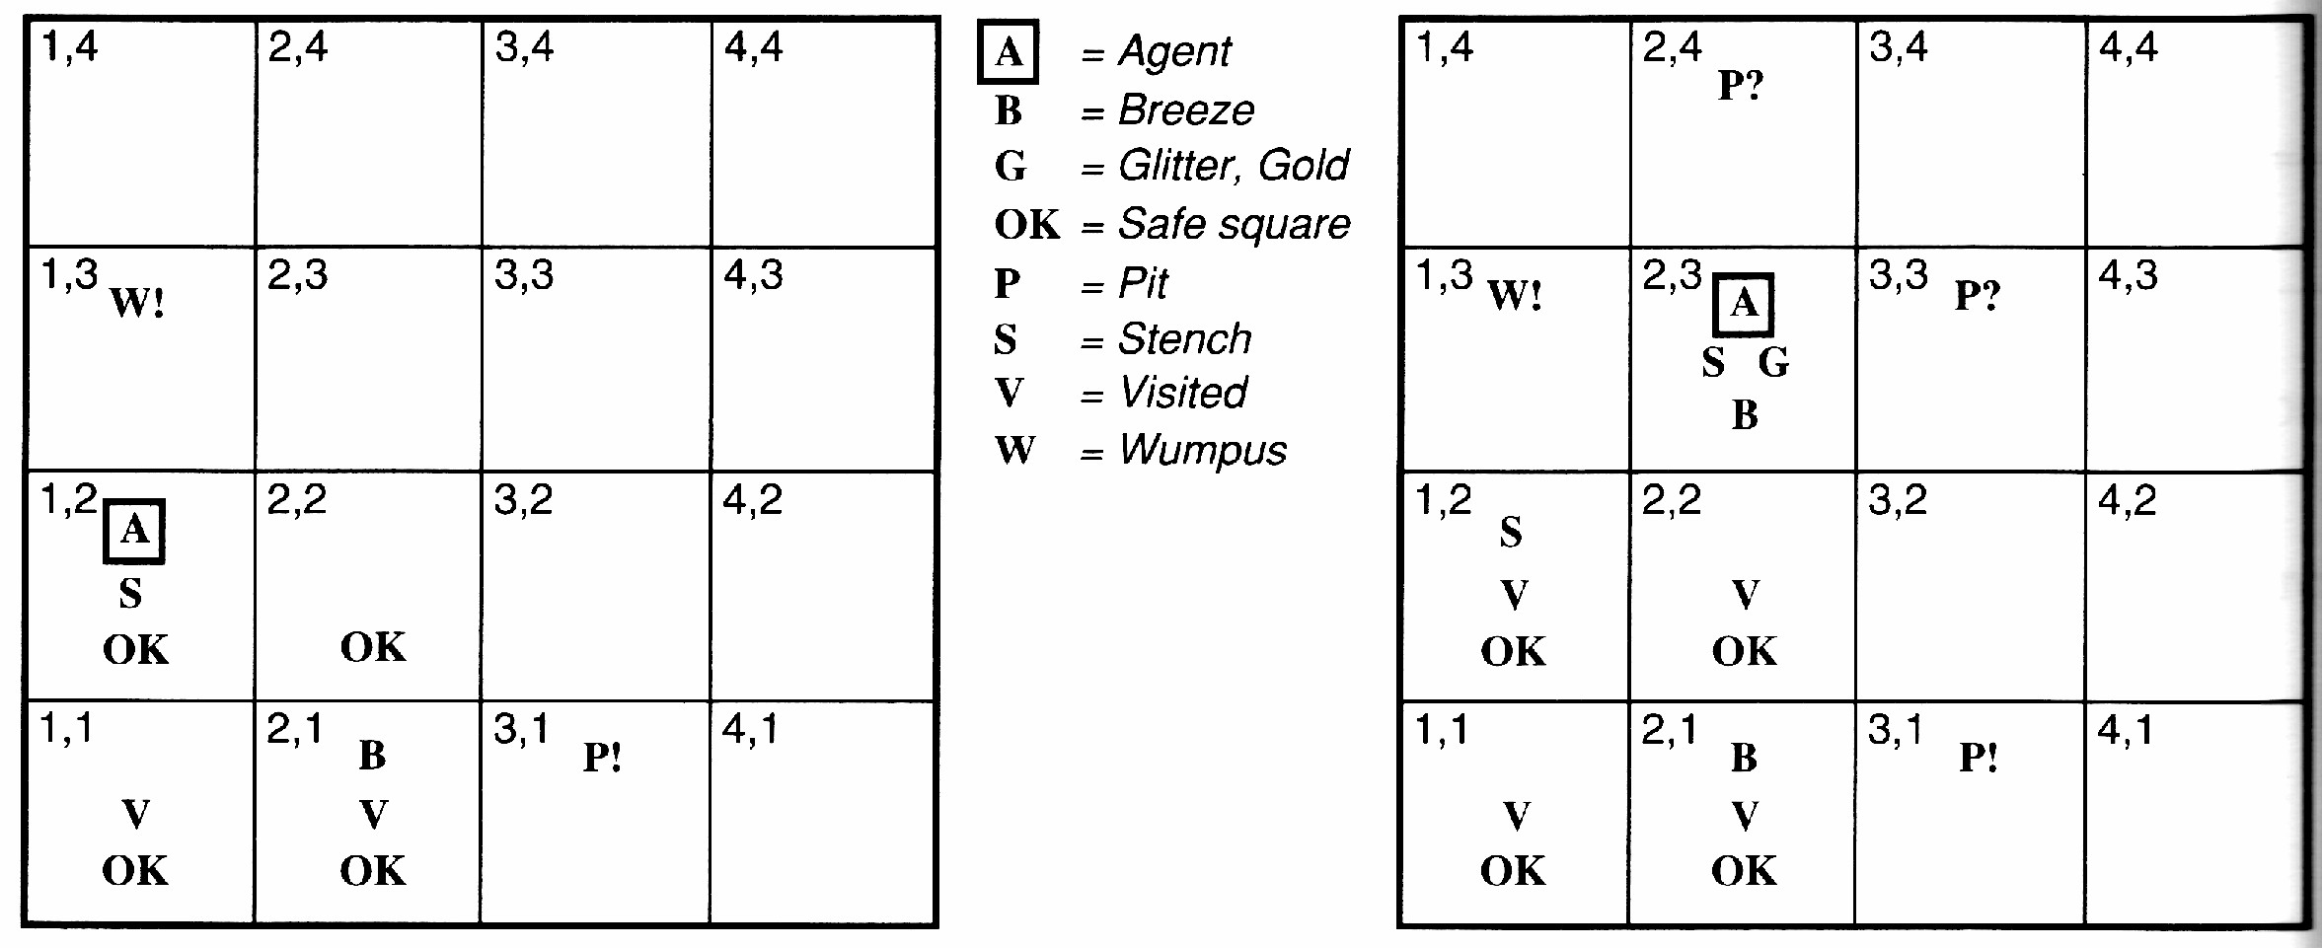
Example Solution
S in 1,2 → 1,3 or 2,2 has W No S in 2,1 → 2,2 OK
2,2 OK → 1,3 W
No B in 1,2 & B in 2,1 → 3,1 P

Slide 19
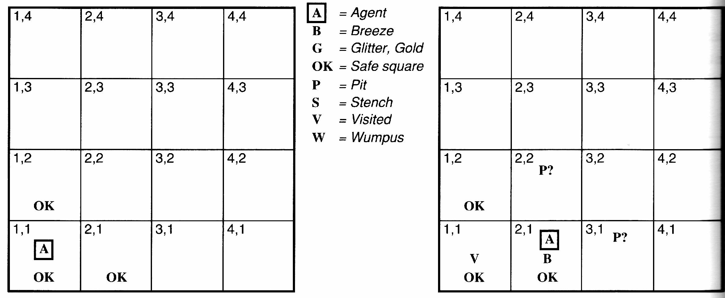
Another example solution
No perception → 1,2 and 2,1 OK Move to 2,1
B in 2,1 → 2,2 or 3,1 P?
1,1 V → no P in 1,2
Move to 1,2 (only option)

Slide 20
Logic in general
Logics are formal languages for representing information such that conclusions can be drawn
Syntax defines the sentences in the language
Semantics define the “meaning” of sentences;
i.e., define truth of a sentence in a world
E.g., the language of arithmetic
x + 2 ≥ y is a sentence; x2+ y > is not a sentence
x + 2 ≥ y is true iff the number x + 2 is no less than the number y
x + 2 ≥ y is true in a world where x=7; y=1
x + 2 ≥ y is false in a world where x=0; y=6

Slide 21
Types of logic
Logics are characterized by what they commit to as “primitives”
Ontological commitment: what exists—facts? objects? time? beliefs?
Epistemological commitment: what states of knowledge?
Language | Ontological Commitment | Epistemological Commitment
Propositional logic | facts | true/false/unknown
First-order logic | facts, objects, relations | true/false/unknown
Temporal logic | facts, objects, relations, times | true/false/unknown
Probability logic | facts | degree of belief 0…1
Fuzzy logic | facts, degree of truth | known interval value

Slide 22

The Semantic Wall
Physical Symbol System
World
+BLOCKA+
+BLOCKB+
+BLOCKC+
P₁:(IS_ON +BLOCKA+ +BLOCKB+) P₂:((IS_RED +BLOCKA+)

Slide 23

Truth depends on Interpretation
Representation 1 World
A B
ON(A,B) T
ON(B,A) F
ON(A,B) F
A
ON(B,A) T
B

Slide 24
Entailment
Entailment means that one thing follows from another:
KB ╞ α
Knowledge base KB entails sentence α
if and only if (iff)
α is true in all worlds where KB is true
E.g., the KB containing “the Giants won” and “the Reds won” entails “Either the Giants won or the Reds won”
E.g., x + y =4 entails 4=x + y
Entailment is a relationship between sentences (i.e., syntax) that is based on semantics
Note: brains process syntax (of some sort)
Entailment is different than inference!

Slide 25
Logic as a representation of the World
entails
Representation: Sentences
Sentence
Refers to (Semantics)
follows
Fact
World
Facts

Slide 26
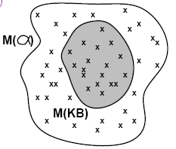
Models
Logicians typically think in terms of models, which are formally structured worlds with respect to which truth can be evaluated
We say m is a model of a sentence α if α is true in m
M(α) is the set of all models of α
Then KB ╞ α if and only if M (KB) µ M(α)
E.g. KB = Giants won and Reds won
α = Giants won

Slide 27
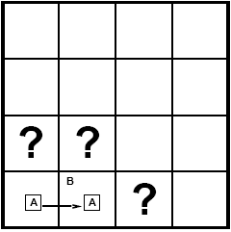
Entailment in the wumpus world
Situation after detecting nothing in [1,1], moving right, breeze in [2,1]
Consider possible models for ?s assuming only pits
3 Boolean choices ➔ 8 possible models

Slide 28
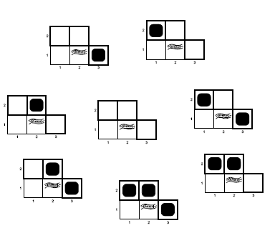
Wumpus models

Slide 29
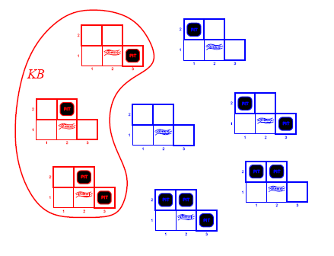
Wumpus Models
KB = wumpus-world rules + observations

Slide 30
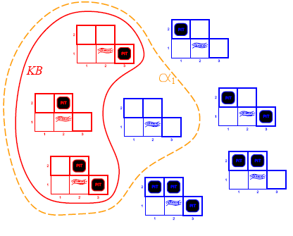
Wumpus Models
KB = wumpus-world rules + observations
α₁ = “[1,2] is safe", KB ╞ α ₁, proved by model checking

Slide 31
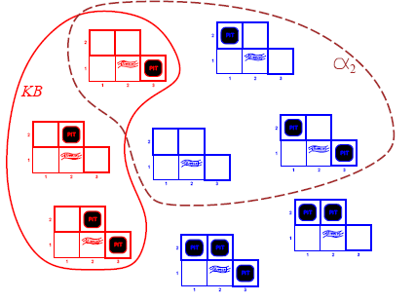
Wumpus Models
KB = wumpus-world rules + observations
α₂ = “[2,2] is safe", KB ╞ \α ₂

Slide 32
Inference
KB α = sentence α can be derived from KB by procedure i
Consequences of KB are a haystack; α is a needle.
Entailment = needle in haystack; inference = finding it
Soundness: i is sound if
whenever KB α, it is also true that KB ╞ α
Completeness: i is complete if
whenever KB ╞ α, it is also true that KB α
Preview: we will define a logic (first-order logic) which is expressive enough to say almost anything of interest, and for which there exists a sound and complete inference procedure.
That is, the procedure will answer any question whose answer follows from what is known by the KB.

Slide 33
Basic symbols
Expressions only evaluate to either “true” or “false.”
P | “P is true”
¬P | “P is false” | negation
P V Q | “either P is true or Q is true or both” | disjunction
P ^ Q | “both P and Q are true” | conjunction
P ➔ Q | “if P is true, the Q is true” | implication
P ⬅➔ Q
“P and Q are either both true or both false” equivalence

Slide 34
Propositional logic: Syntax
Propositional logic is the simplest logic—illustrates basic ideas The proposition symbols P₁, P₂ etc are sentences
If S is a sentence, ¬S is a sentence (negation)
If S₁ and S₂ are sentences, S₁ ∧ S₂ is a sentence (conjunction)
If S₁ and S₂ are sentences, S₁ ∨ S₂ is a sentence (disjunction)
If S₁ and S₂ are sentences, S₁ ⇒ S₂ is a sentence (implication)
If S₁ and S₂ are sentences, S₁ ⇔ S₂ is a sentence (biconditional)

Slide 35
Precedence
Use parentheses
A ➔ B ➔ C is not allowed

Slide 36
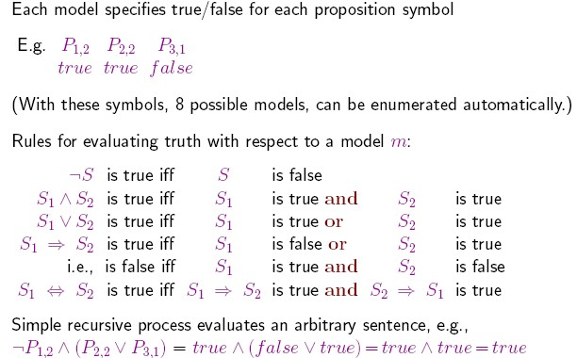
Propositional logic: Semantics

Slide 37
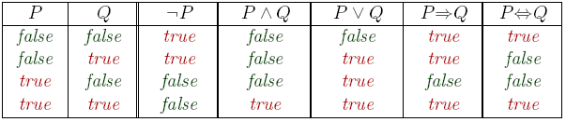
Truth tables for connectives

Slide 38
Wumpus world sentences
Let P_{i;j}
be true if there is a pit in [i;j].
Let B_{i;j} be true if there is a breeze in [i;j].
^{P}1;1 ^{B}1;1 ^{B}2;1
“Pits cause breezes in adjacent squares”

Slide 39
Wumpus world sentences
Let P_{i;j}
be true if there is a pit in [i;j].
Let B_{i;j} be true if there is a breeze in [i;j].
^{P}1;1 ^{B}1;1 ^{B}2;1
“Pits cause breezes in adjacent squares”
^{B}1;1 ⬄ ^{(P}1,2 ^{V P}2;1⁾
^{B}2;1 ⬄ ^{(P}1,1 ^{V P}2;2 ^{V P}311⁾
“A square is breezy if and only if there is an adjacent pit”

Slide 40
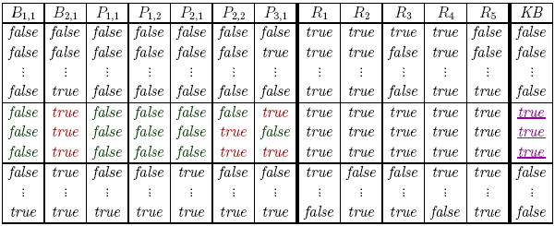
Truth tables for inference
Enumerate rows (different assignments to symbols), if KB is true in row, check that α is too

Slide 41
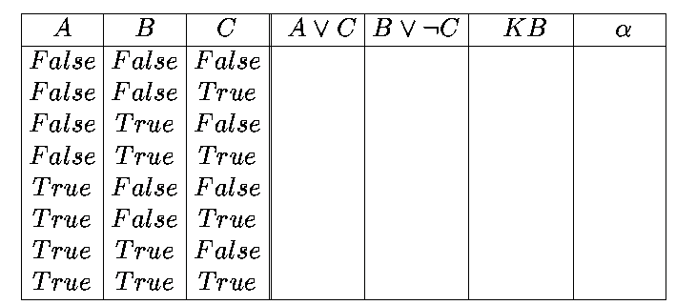
Propositional inference: enumeration method
Let α = A V B and KB = (A V C ) ^ (B V ¬C)
Is it the case that KB ╞ α?
Check all possible models—α must be true wherever KB is true

Slide 42
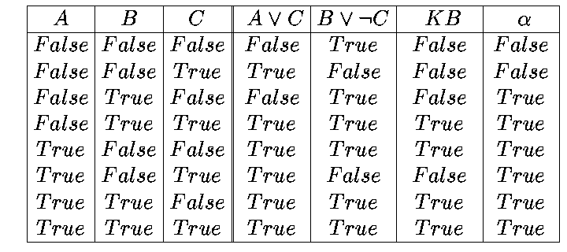
Enumeration: Solution
Let α = A V B and KB = (A V C ) ^ (B V ¬C)
Is it the case that KB ╞ α?
Check all possible models—α must be true wherever KB is true

Slide 43
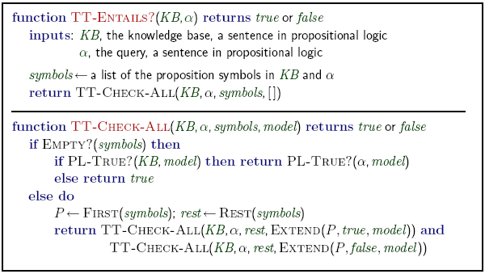
Inference by enumeration
Depth-first enumeration of all models is sound and complete
O(2^{n}) for n symbols; problem is co-NP-complete

Slide 44
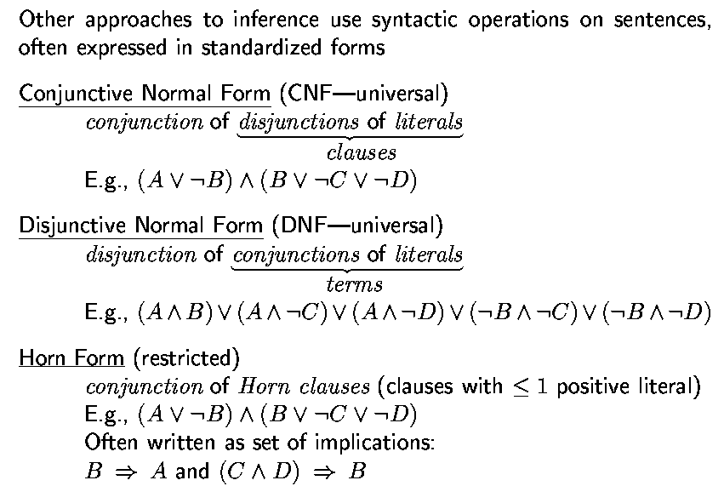
Propositional inference: normal forms
“product of sums of simple variables or negated simple variables”
“sum of products of simple variables or negated simple variables”

Slide 45
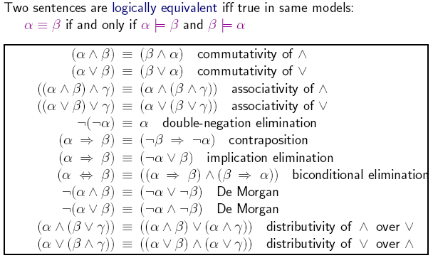
Logical equivalence

Slide 46
Validity and satisfiability
A sentence is valid if it is true in all models,
e.g., True, A V ¬ A, A ➔ A, (A ^ (A ➔ B)) ➔ B
Validity is connected to inference via the Deduction Theorem:
KB ╞ α if and only if (KB ➔ α) is valid
A sentence is satisfiable if it is true in some model e.g., A V B, C
A sentence is unsatisfiable if it is true in no models e.g., A ^ ¬ A
Satisfiability is connected to inference via the following:
KB ╞ α if and only if (KB ^ : ¬ α) is unsatisfiable
i.e., prove α by reductio ad absurdum

Slide 47
Example

Slide 48
Satisfiability
Related to constraint satisfaction
Given a sentence S, try to find an interpretation I where S is true
Analogous to finding an assignment of values to variables such that the constraint hold
Example problem: scheduling nurses in a hospital
Propositional variables represent for example that Nurse1 is working on Tuesday at 2
Constraints on the schedule are represented using logical expressions over the variables
Brute force method: enumerate all interpretations
and check

Slide 49
Example problem
Imagine that we knew that:
If today is sunny, then Amir will be happy
(S→ H)
If Amir is happy, then the lecture will be good
(H → G)
Today is Sunny (S)
Should we conclude that today the lecture will be good

Slide 50
Checking Interpretations
Start by figuring out what set of interpretations
make our original sentences true.
Then, if G is true in all those interpretations, it must
be OK to conclude it from the sentences we started
out with (our knowledge base).
• In a universe with only three variables, there are 8
possible interpretations in total.

Slide 51
Checking Interpretations
Only one of these
interpretations makes all the
sentences in our knowledge
base true:
S = true, H = true, G = true.

Slide 52
Checking Interpretations
it's easy enough to check that G
is true in that interpretation, so it
seems like it must be reasonable
to draw the conclusion that the
lecture will be good.

Slide 53
Computing entailement

Slide 54
Entailment and Proof

Slide 55
Proof

Slide 56
Proof methods
Proof methods divide into (roughly) two kinds:
Application of inference rules
Legitimate (sound) generation of new sentences from old
Proof = a sequence of inference rule applications
Can use inference rules as operators in a standard search alg.
Typically require translation of sentences into a normal form
Model checking
truth table enumeration (always exponential in n)
improved backtracking, e.g., Davis—Putnam—Logemann—Loveland
heuristic search in model space (sound but incomplete) e.g., min-conflicts-like hill-climbing algorithms

Slide 57
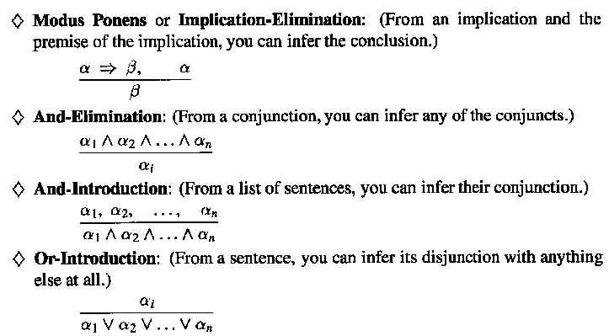
Inference rules

Slide 58
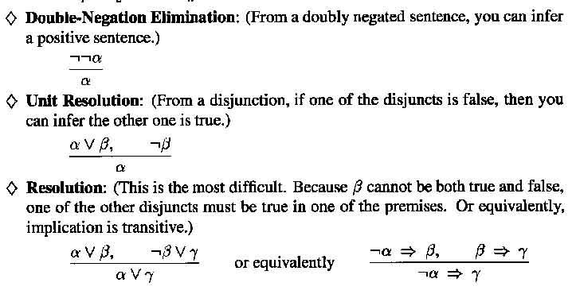
Inference Rules

Slide 59
Example
46
Prove S
Step | Formula | Derivation
1 | P ∧ Q | Given
2 | p → R | Given
3 | {Q ∧ R) → S | Given

Slide 60
Example
47
Prove S
Step | Formula | Derivation
1 | P ∧ Q | Given
2 | p → R | Given
3 | {Q ∧ R) → S | Given
4 | P | 1 And Elimin

Slide 61
Example
48
Prove S
Step | Formula | Derivation
1 | P ∧ Q | Given
2 | p → R | Given
3 | {Q ∧ R) → S | Given
4 | P | 1 And Elimin
5 | R | 4,2 Modus Ponens

Slide 62
Example
49
Prove S
Step | Formula | Derivation
1 | P ∧ Q | Given
2 | p → R | Given
3 | {Q ∧ R) → S | Given
4 | P | 1 And Elimin
5 | R | 4,2 Modus Ponens
6 | Q | 1 And Elimin

Slide 63
Example
50
Prove S
Step | Formula | Derivation
1 | P ∧ Q | Given
2 | p → R | Given
3 | {Q ∧ R) → S | Given
4 | P | 1 And Elimin
5 | R | 4,2 Modus Ponens
6 | Q | 1 And Elimin
7 | Q ∧ R | 5,6 And-Intro

Slide 64
Example
51
Prove S
Step | Formula | Derivation
1 | P ∧ Q | Given
2 | p → R | Given
3 | {Q ∧ R) → S | Given
4 | P | 1 And Elimin
5 | R | 4,2 Modus Ponens
6 | Q | 1 And Elimin
7 | Q ∧ R | 5,6 And-Intro
8 | S | 7,3 Modus Ponens

Slide 65
Wumpus world: example
Facts: Percepts inject (TELL) facts into the KB
[stench at 1,1 and 2,1]
Rules: if square has no stench then neither the square or adjacent square contain the wumpus
◦ R₁: ¬S_{1,1} ➔ ¬W_{1,1} ^ ¬W_{1,2} ^ ¬W_{2,1}
◦ R₂ : ¬S_{2,1} ➔ ¬W_{1,1} ^ ¬W_{2,1} ^ ¬W_{2,2} ^ ¬W_{3,1}
…
Inference:
KB contains ¬S_{1,1} then using Modus Ponens we infer
^{¬W}1,1 ^{^ ¬W}1,2 ^{^ ¬W}2,1
Using And-Elimination we get:
^{¬W}1,1 ^{¬W}1,2 ^{¬W}2,1
^{→ S}1,1 ^{; S}2,1

Slide 66
Example from Wumpus World
52
R1: ¬ P_{1,1} R2: ¬B_{1,1} R3: B_{2,1} R4: B_{1,1} ⇔
^{(P}1,2 ^{∨ P}2,1⁾
R5: B_{2,1} ⇔(P_{1,1} ∨ P_{2,2} ∨ P_{3,1})
KB = R1 ∧ R2 ∧ R3 ∧ R4 ∧ R5
Prove α1 = ¬ P_{1,2}

Slide 67
Example from Wumpus World
53
R1: ¬ P_{1,1} R2: ¬B_{1,1} R3: B_{2,1} R4: B_{1,1} ⇔
^{(P}1,2 ^{∨ P}2,1⁾
R5: B_{2,1} ⇔(P_{1,1} ∨ P_{2,2} ∨ P_{3,1})
R6 : B_{1,1} ⇔
(B_{1,1} ⇒ (P_{1,2} ∨ P_{2,1})) ∧((P_{1,2} ∨ P_{2,1}) ⇒ B_{1,1})
Biconditional elimination

Slide 68
Example from Wumpus World
54
R1: ¬ P_{1,1} R2: ¬B_{1,1} R3: B_{2,1} R4: B_{1,1} ⇔
^{(P}1,2 ^{∨ P}2,1⁾
R5: B_{2,1} ⇔(P_{1,1} ∨ P_{2,2} ∨ P_{3,1})
R6 : B_{1,1} ⇔
(B_{1,1} ⇒ (P_{1,2} ∨ P_{2,1})) ∧((P_{1,2} ∨ P_{2,1}) ⇒ B_{1,1})
Biconditional elimination
R7 : ((P_{1,2} ∨ P_{2,1}) ⇒ B_{1,1}) And Elimination

Slide 69
Example from Wumpus World
55
R1: ¬ P_{1,1} R2: ¬B_{1,1} R3: B_{2,1} R4: B_{1,1} ⇔
^{(P}1,2 ^{∨ P}2,1⁾
R5: B_{2,1} ⇔(P_{1,1} ∨ P_{2,2} ∨ P_{3,1})
R6 : B_{1,1} ⇔ (B_{1,1} ⇒ (P_{1,2} ∨ P_{2,1})) ∧((P_{1,2} ∨ P_{2,1}) ⇒ B_{1,1})
Biconditional elimination
R7 : ((P_{1,2} ∨ P_{2,1}) ⇒ B_{1,1}) And Elimination
R8: (¬ B_{1,1} ⇒ ¬ (P_{1,2} ∨ P_{2,1})) Equivalence for contrapositives

Slide 70
Example from Wumpus World
56
R1: ¬ P_{1,1} R2: ¬B_{1,1} R3: B_{2,1} R4: B_{1,1} ⇔
^{(P}1,2 ^{∨ P}2,1⁾
R5: B_{2,1} ⇔(P_{1,1} ∨ P_{2,2} ∨ P_{3,1})
R6 : B_{1,1} ⇔ (B_{1,1} ⇒ (P_{1,2} ∨ P_{2,1})) ∧((P_{1,2} ∨ P_{2,1}) ⇒ B_{1,1})
Biconditional elimination
R7 : ((P_{1,2} ∨ P_{2,1}) ⇒ B_{1,1}) And Elimination
R8: (¬ B_{1,1} ⇒ ¬ (P_{1,2} ∨ P_{2,1})) Equivalence for contrapositives R9: ¬ (P_{1,2} ∨ P_{2,1}) Modus Ponens with R2 and R8

Slide 71
Example from Wumpus World
57
R1: ¬ P_{1,1} R2: ¬B_{1,1} R3: B_{2,1} R4: B_{1,1} ⇔
^{(P}1,2 ^{∨ P}2,1⁾
R5: B_{2,1} ⇔(P_{1,1} ∨ P_{2,2} ∨ P_{3,1})
R6 : B_{1,1} ⇔
(B_{1,1} ⇒ (P_{1,2} ∨ P_{2,1})) ∧((P_{1,2} ∨ P_{2,1}) ⇒ B_{1,1})
Biconditional elimination And Elimination
Equivalence for contrapositives Modus Ponens with R2 and R8 De Morgan’s Rule
R7 : ((P_{1,2} ∨ P_{2,1}) ⇒ B_{1,1})
R8: (¬ B_{1,1} ⇒ ¬ (P_{1,2} ∨ P_{2,1})) R9: ¬ (P_{1,2} ∨ P_{2,1})
R10: ¬ P_{1,2} ∧ ¬ P_{2,1}

Slide 72
Example from Wumpus World
58
R1: ¬ P_{1,1} R2: ¬B_{1,1} R3: B_{2,1} R4: B_{1,1} ⇔
^{(P}1,2 ^{∨ P}2,1⁾
R5: B_{2,1} ⇔(P_{1,1} ∨ P_{2,2} ∨ P_{3,1})
R6 : B_{1,1} ⇔
(B_{1,1} ⇒ (P_{1,2} ∨ P_{2,1})) ∧((P_{1,2} ∨ P_{2,1}) ⇒ B_{1,1})
Biconditional elimination And Elimination
Equivalence for contrapositives Modus Ponens with R2 and R8 De Morgan’s Rule
And Elimination
R7 : ((P_{1,2} ∨ P_{2,1}) ⇒ B_{1,1})
R8: (¬ B_{1,1} ⇒ ¬ (P_{1,2} ∨ P_{2,1})) R9: ¬ (P_{1,2} ∨ P_{2,1})
R10: ¬ P_{1,2} ∧ ¬ P_{2,1} R11: ¬ P_{1,2}

Slide 73
Forward and backward chaining
Horn Form (restricted)
KB = conjunction of Horn clauses
Horn clause =
proposition symbol; or (conjunction of symbols) ➔ symbol
E.g., C ^ (B ➔ A) ^ (C ^ D ➔ B)
Modus Ponens (for Horn Form): complete for Horn KBs
α₁; … ; α _{n} ; α ₁ ^ … ^ α _{n} ) ➔ β
β
Can be used with forward chaining or backward chaining.
These algorithms are very natural and run in linear time

Slide 74
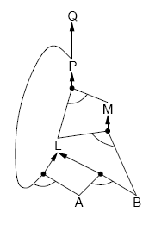
Forward chaining
Idea: fire any rule whose premises are satisfied in the KB, add its conclusion to the KB, until query is found
P ⇒ Q
L ∧ M ⇒ P
B ∧ L ⇒ M
A ∧ P ⇒ L
A ∧ B ⇒ L
A
B

Slide 75
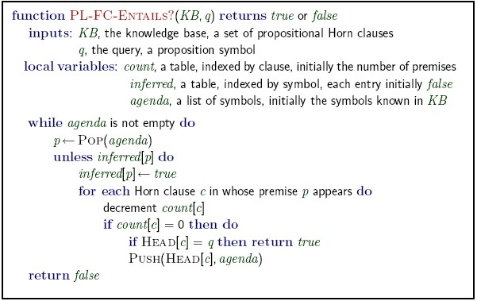
Forward chaining algorithm

Slide 76
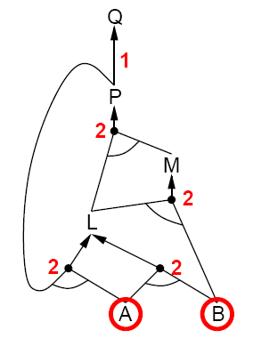
Forward chaining example
P ➔Q
L ^ M ➔P
B ^ L ➔M
A ^ P ➔L
A ^ B ➔L
A
B

Slide 77
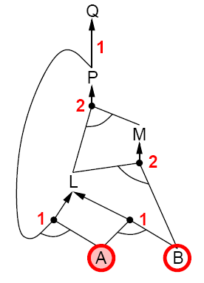
Forward chaining example
P ➔Q
L ^ M ➔P
B ^ L ➔M
A ^ P ➔L
A ^ B ➔L
A
B

Slide 78
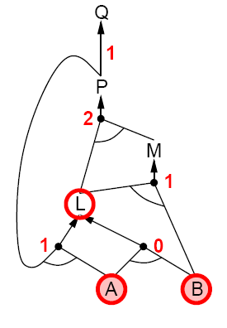
Forward chaining example
P ➔Q
L ^ M ➔P
B ^ L ➔M
A ^ P ➔L
A ^ B ➔L
A
B

Slide 79
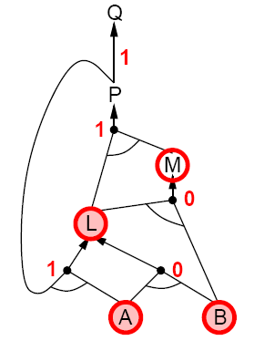
Forward chaining example
P ➔Q
L ^ M ➔P
B ^ L ➔M
A ^ P ➔L
A ^ B ➔L
A
B

Slide 80
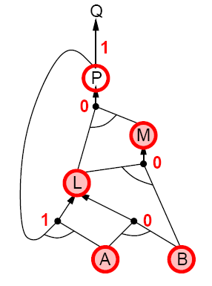
Forward chaining example
P ➔Q
L ^ M ➔P
B ^ L ➔M
A ^ P ➔L
A ^ B ➔L
A
B

Slide 81
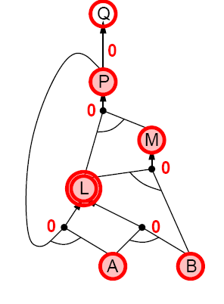
Forward chaining example
P ➔Q
L ^ M ➔P
B ^ L ➔M
A ^ P ➔L
A ^ B ➔L
A
B

Slide 82
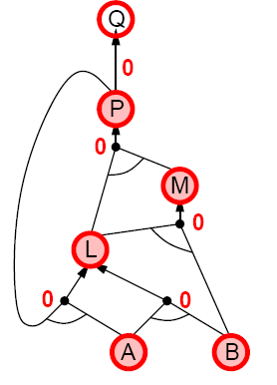
Forward chaining example
P ➔Q
L ^ M ➔P
B ^ L ➔M
A ^ P ➔L
A ^ B ➔L
A
B

Slide 83
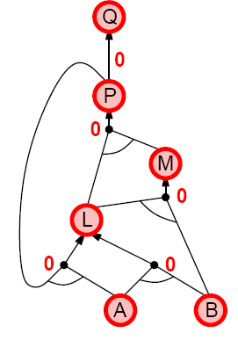
Forward chaining example
P ➔Q
L ^ M ➔P
B ^ L ➔M
A ^ P ➔L
A ^ B ➔L
A
B

Slide 84
Proof of completeness
FC derives every atomic sentence that is entailed by KB
FC reaches a fixed point where no new atomic sentences are derived
Consider the final state as a model m, assigning true/false to symbols
Every clause in the original KB is true in m
Proof: Suppose a clause α₁ ^ … ^ α_{k} ➔ b is false in m
Then α₁ ^ … ^ α_{k} is true in m and b is false in m
Therefore the algorithm has not reached a fixed point!
Hence m is a model of KB
If KB ╞ q, q is true in every model of KB, including m
General idea: construct any model of KB by sound inference, check α

Slide 85
Backward chaining
Idea: work backwards from the query q: to prove q by BC,
check if q is known already, or
prove by BC all premises of some rule concluding q
Avoid loops: check if new subgoal is already on the goal stack
Avoid repeated work: check if new subgoal
has already been proved true, or
has already failed

Slide 86
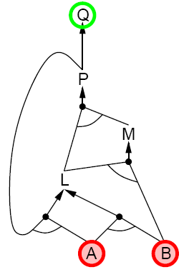
Backward chaining example
P ➔Q
L ^ M ➔P
B ^ L ➔M
A ^ P ➔L
A ^ B ➔L
A
B

Slide 87
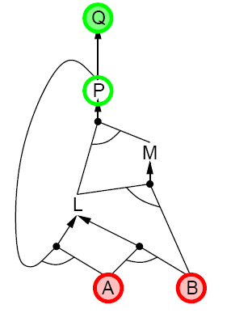
Backward chaining example
P ➔Q
L ^ M ➔P
B ^ L ➔M
A ^ P ➔L
A ^ B ➔L
A
B

Slide 88
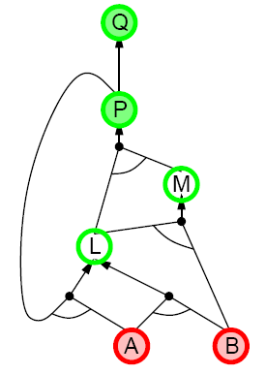
Backward chaining example
P ➔Q
L ^ M ➔P
B ^ L ➔M
A ^ P ➔L
A ^ B ➔L
A
B

Slide 89
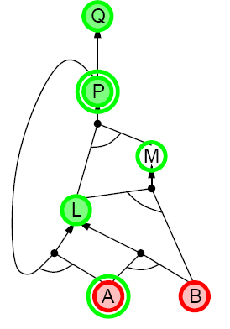
Backward chaining example
P ➔Q
L ^ M ➔P
B ^ L ➔M
A ^ P ➔L
A ^ B ➔L
A
B

Slide 90
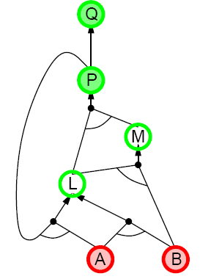
Backward chaining example
P ➔Q
L ^ M ➔P
B ^ L ➔M
A ^ P ➔L
A ^ B ➔L
A
B

Slide 91
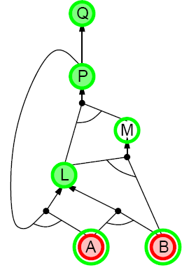
Backward chaining example
P ➔Q
L ^ M ➔P
B ^ L ➔M
A ^ P ➔L
A ^ B ➔L
A
B

Slide 92
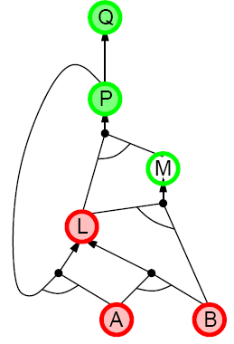
Backward chaining example
P ➔Q
L ^ M ➔P
B ^ L ➔M
A ^ P ➔L
A ^ B ➔L
A
B

Slide 93
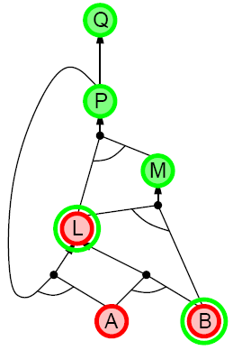
Backward chaining example
P ➔Q
L ^ M ➔P
B ^ L ➔M
A ^ P ➔L
A ^ B ➔L
A
B

Slide 94
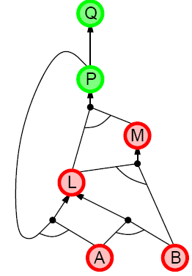
Backward chaining example
P ➔Q
L ^ M ➔P
B ^ L ➔M
A ^ P ➔L
A ^ B ➔L
A
B

Slide 95
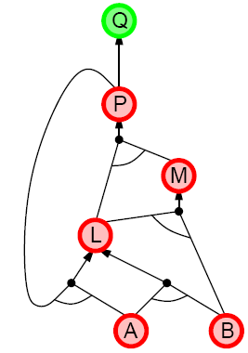
Backward chaining example
P ➔Q
L ^ M ➔P
B ^ L ➔M
A ^ P ➔L
A ^ B ➔L
A
B

Slide 96

Backward chaining example
P ➔Q
L ^ M ➔P
B ^ L ➔M
A ^ P ➔L
A ^ B ➔L
A
B

Slide 97
Forward vs. backward chaining
FC is data-driven, cf. automatic, unconscious processing, e.g., object recognition, routine decisions
May do lots of work that is irrelevant to the goal BC is goal-driven, appropriate for problem-solving,
e.g., Where are my keys? How do I get into a PhD program?
Complexity of BC can be much less than linear in size of KB

Slide 98

Resolution

Slide 99

Conversion to CNF

Slide 101

Resolution algorithm
Proof by contradiction, i.e., show KB ^ not(α) unsatisfiable

Slide 102



Resolution example

Slide 103
Converting to CNF

Slide 104
Limitations of Propositional Logic
1. It is too weak, i.e., has very limited expressiveness:
Each rule has to be represented for each situation:
e.g., “don’t go forward if the wumpus is in front of you” takes 64 rules
2. It cannot keep track of changes:
If one needs to track changes, e.g., where the agent has been before then we need a timed-version of each rule. To track 100 steps we’ll then need 6400 rules for the previous example.
Its hard to write and maintain such a huge rule-base
Inference becomes intractable

